Slide 1
Machine Learning
“A field of study that gives computers the capability to learn without being explicitly programmed."

Slide 2
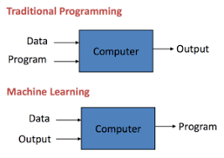
How it is different from traditional Programming:
In Traditional Programming, we feed the Input, Program logic and run the program to get output.
In Machine Learning, we feed the input, output and run it on machine during training and the machine creates its own logic, which is being evaluated while testing.

Slide 3
Terminologies:
Model: A model is a specific representation learned from data by applying some machine learning algorithm. A model is also called hypothesis.
Feature: A feature is an individual measurable property of data. A set of numeric features can be conveniently described by a feature vector. Feature vectors are fed as input to the model. For example, in order to predict a fruit, there may be features like color, smell, taste, etc.
Target(Label): A target variable or label is the value to be predicted by our model. For the fruit example discussed in the features section, the label with each set of input would be the name of the fruit like apple, orange, banana, etc.
Training: The idea is to give a set of inputs(features) and it’s expected outputs(labels), so after training, we will have a model (hypothesis) that will then map new data to one of the categories trained on.
Prediction: Once the model is ready, it can be fed a set of inputs to which it will provide a predicted output(label).

Slide 4
Types of Learning:
Supervised Learning
– Given: training data + desired outputs (labels)
Unsupervised Learning
– Given: training data (without desired outputs)
Semi-Supervised Learning
– Given: training data + a few desired outputs
Reinforcement Learning
– Rewards from sequence of actions

Slide 5
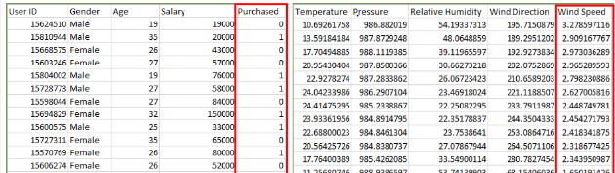
1. Supervised Learning
Supervised learning is when the model is getting trained on a labelled dataset. Labelled dataset is one which have both input and output parameters. In this type of learning both training and validation datasets are labelled as shown in the figures below.

Slide 6
Types of Supervised Learning: (Classification & Regression)
Classification : It is a Supervised Learning task where output is having defined labels(discrete value). For example, in above Figure, Output – Purchased has defined labels i.e. 0 or 1 ; 1 means the customer will purchase and 0 means that customer won’t purchase.
– Gmail classifies mails in more than one classes like social, promotions, updates, offers.
Regression : It is a Supervised Learning task where output is having continuous value. For example, in before Figure, Output – Wind Speed is not having any discrete value but is continuous in the particular range. The goal here is to predict a value as much closer to actual output value as our model can and then evaluation is done by calculating error value.
– Recall DIAML assignments (Predicting house prices)

Slide 7
Example of Supervised Learning Algorithms:
Linear Regression
Nearest Neighbor
Gaussian Naive Bayes
Decision Trees
Support Vector Machine (SVM)
Random Forest

Slide 8
2. Unsupervised Learning:
Unsupervised learning is the training of machine using information that is neither classified nor labeled and allowing the algorithm to act on that information without guidance. Here the task of the machine is to group unsorted information according to similarities, patterns and differences without any prior training of data. Unsupervised machine learning is more challenging than supervised learning due to the absence of labels.

Slide 9
Types of Unsupervised Learning: (Clustering & Association)
Clustering: A clustering problem is where you want to discover the inherent groupings in the data, such as grouping customers by purchasing behavior.
Association: An association rule learning problem is where you want to discover rules that describe large portions of your data, such as people that buy X also tend to buy Y.
Examples of unsupervised learning algorithms are:
k-means for clustering problems.
Apriori algorithm for association rule learning problems
The most basic disadvantage of any Supervised Learning algorithm is that the dataset has to be hand-labeled either by a Machine Learning Engineer or a Data Scientist. This is a very costly process, especially when dealing with large volumes of data.

Slide 10
3. Semi-supervised machine learning:
To counter these disadvantages, the concept of Semi-Supervised Learning was introduced. In this type of learning, the algorithm is trained upon a combination of labeled and unlabeled data. Typically, this combination will contain a very small amount of labeled data and a very large amount of unlabeled data.
Labelled data is used to learn a model and using that model, unlabeled data is labelled, called pseudo labelling. Now, using whole data, the model is trained for further use

Slide 11
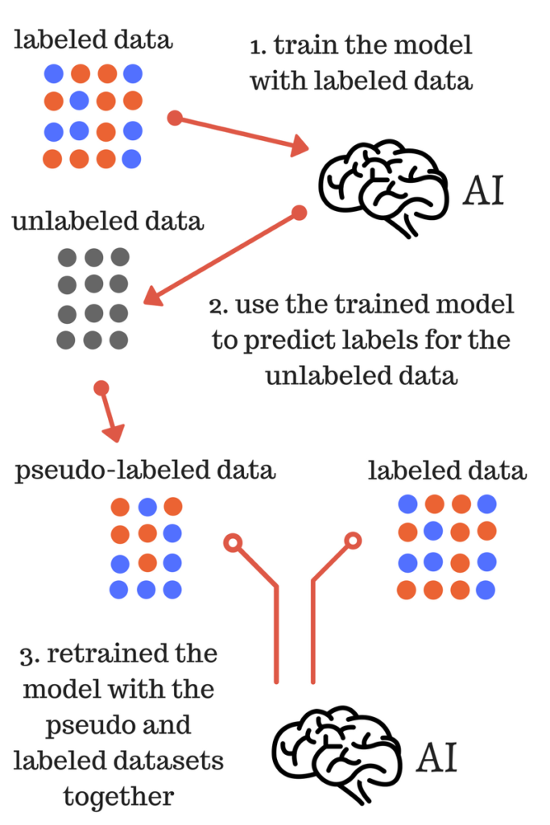

Slide 12
4. Reinforcement Learning
Given a sequence of states and actions with (delayed) rewards, output a policy
– Policy is a mapping from states to actions that tells you what to do in a given state
Examples Include:
Credit assignment problem
Game playing
Robot in a maze
Balance a pole on your hand

Slide 13
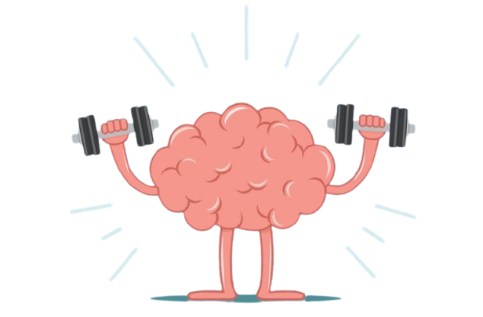
Intuitively, one may imagine the four types of learning algorithms as Supervised learning where a student is under the supervision of a teacher at both home and school, Unsupervised learning where a student has to figure out a concept himself, Semi-Supervised learning where a teacher teaches a few concepts in class and gives questions as homework which are based on similar concepts and Reinforcement learning where you reward that student when they perform well to encourage continuous improvement.

Slide 14
REGRESSION

Slide 15
REGRESSION
Regression is a statistical measurement used in finance, investing, and other disciplines that attempts to determine the strength of the relationship between one dependent variable and a series of other changing variables or independent variable

Slide 16
Types of regression:
Linear regression
Simple linear regression
Multiple linear regression
Polynomial regression
Decision tree regression
Random forest regression

Slide 17
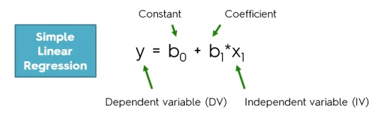
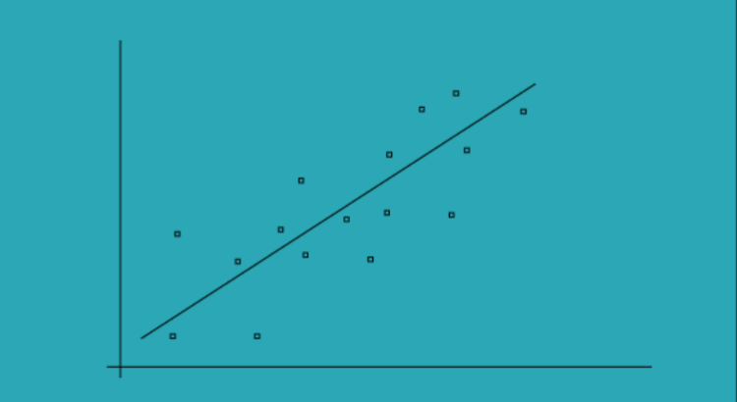
Simple Linear regression:
Simple linear regression models are used to show or predict the relationship between the two variables or factors. The factor that being predicted is called dependent variable and the factors that is are used to predict the dependent variable are called independent variables.
Simple Linear regression

Slide 18
Let’s write some codes

